Slide 1

A Look at the Relationship between Environments, Economies, and Human Development
Farah, Prinssi, Vaidy

Slide 2
Project guidelines – delete when finished
Be at least 8-10 min. long
Describe the core message or hypothesis for your project.
Describe the questions you and your group found interesting, and what motivated you to answer them
Summarize where and how you found the data you used to answer these questions
Describe the data exploration and cleanup process (accompanied by your Jupyter Notebook)
Describe the analysis process (accompanied by your Jupyter Notebook)
Summarize your conclusions. This should include a numerical summary (i.e., what data did your analysis yield), as well as visualizations of that summary (plots of the final analysis data)
Discuss the implications of your findings. This is where you get to have an open-ended discussion about what your findings "mean".
Tell a good story! Storytelling through data analysis is no different than in literature. Find your narrative and use your analysis and visualization skills to highlight conflict and resolution in your data.

Slide 3
Project overview

Slide 4
What were we trying to accomplish?
Validate or nullify perceived relationship between Happiness, Human Development and Environment
Do environmental variables affect social and economic features
Build “Utopia”

Slide 5
Did it work?
For the most part, of course it was difficult to hone in on how to create a utopia. Given the time and data we were successful. We will discuss this further…

Slide 6
Summary – need to write this
briefly summarize your findings

Slide 7
Datasets:
Environmental Variables
Country
Accessibility_to_cities:
Elevation
Aspect: orientation of slope
Slope
Cropland cover
Tree canopy cover
Temp max of the warmest month
Rain seasonality/ other train data
Temp – diurnal range
Isothermality
Human Development Index (HDI)
Country
HDI score (0-1)
GNI (Gross National Income)
Population
Internet users
Life expectancy
Dependency ratios
Inequality datasets
Deaths due to Tuberculosis (per 100,000 people)
Deaths due to Tuberculosis (per 100,000 people)
Total fertility rate (birth per woman) 2000/2007
% of population in cities
Secondary education
# of physicians per 10,000 people
Public health expenditure
World Happiness
Country
Happiness Score: A metric measured in 2017 by asking the sampled people the question: "How would you rate your happiness on a scale of 0 to 10 where 10 is the happiest."
Generosity:
Dystopia Residual:
Trust (Government Corruption):
Family:
Health (Life Expectancy):

Slide 8
Data cleanup & exploration

Slide 9
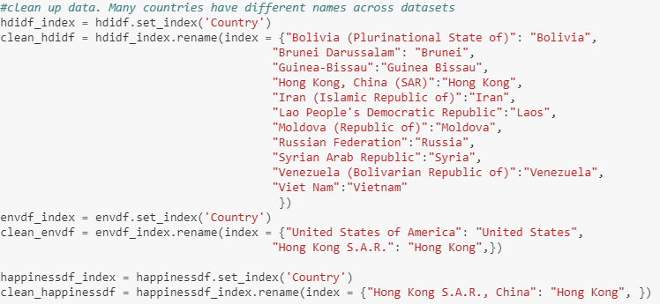
How did we clean up the data
Identify mismatch in country names
Uniform country names
Inner join of countries to maintain data integrity
Notes:
-a lot of country data in some were cities/territories and not countries

Slide 10
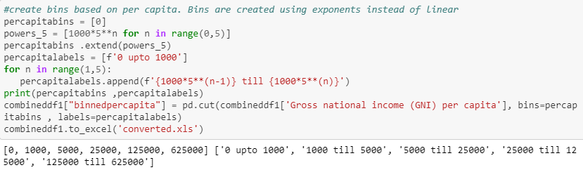
Data exploration
Binning the countries by Gross National Income (GNI) per capita
Binned them by powers of 5 based on data skew

Slide 11
Data analysis

Slide 12
Data Analysis – delete slide when finished
Discuss the steps you took to analyze the data
Present and discuss interesting figures developed during analysis, ideally with the help of Jupyter Notebook
Discuss your findings.
Did you find what you expected to find? If not, why not?
What inferences or general conclusions can you draw from your analysis?

Slide 13
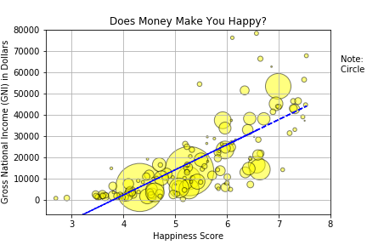
Is there a positive relationship between happiness and GNI? (i.e are people in wealthier countries happier?)

Slide 14
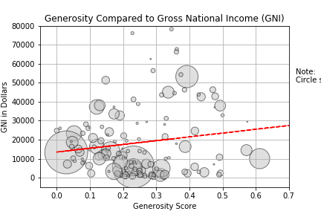
Is there a positive relationship between GNI and generosity?

Slide 15
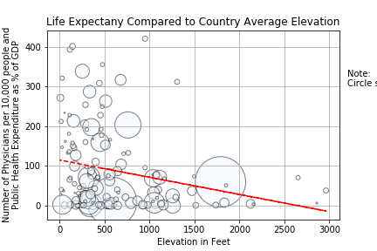
Is there a negative relationship between elevation and access to healthcare?

Slide 16
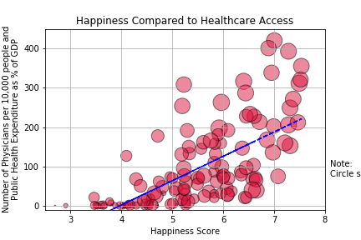
Is there a positive relationship between health and happiness?

Slide 17
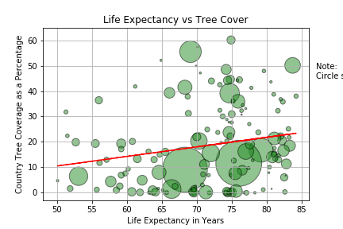
Do people in countries with more tree cover live longer?

Slide 18
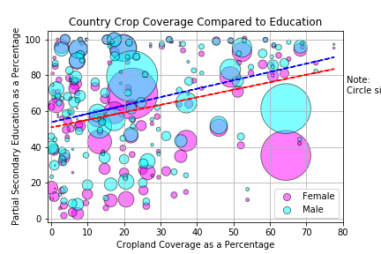
Is there is a negative relationship between crop cover and education?

Slide 19
Utopia - What
How to build a happy colony
Build a model to “learn” with existing data
Create colonies with specific features
Predict Happiness score
What comprises happiest colony?

Slide 20
Utopia - How
Identify correlation between Happiness and other features
Choose the features at extreme ends of correlation
Clean up/fix nulls
Build a model based on above features
Create a colony

Slide 21
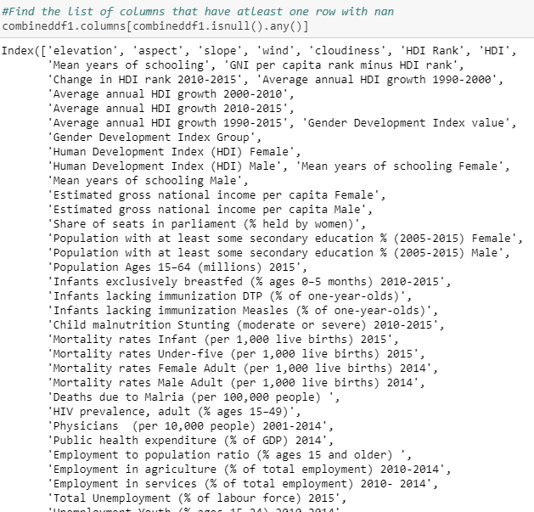
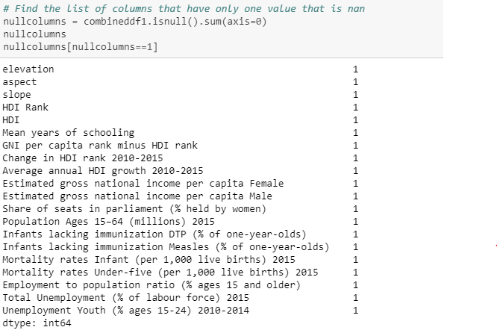
Utopia - How

Slide 22
Post mortem

Slide 23
Looking back
Defining some variables were tricky
GDP was initially how we planned to look at each country’s economy, had to look at GNI instead
General ‘health’ was difficult to hone in on, decided to use access to healthcare, physician stats, life expectancy, and public health expenditure where relevant
Education also had many factors, we used partial secondary education
The years of data ranged from 2014-17
GitHub and its respective commands were challenging, referred back to the lessons and used each other as resources in any pitfalls
Due to the plethora of data, we could have addressed several possible relationships & even compiled stats together to do a deeper analysis since variables are not typically independent of each other
Looking at some outlier countries such as India and China and understanding where they may be lacking or innovating would be interesting to dive into as well
If we had more time, asking tougher/more general research questions would be interesting such as what are key differences between countries with an above average happiness, developed countries, regionality, seasonality, etc.

Slide 24
Thank You. Questions?

